Slide 1
Project Proposal: YourTitleHere
FirstName LastName
StudentNumber

Slide 2
Ordered Table of Contents
Value Proposition: What computer vision application will you make and why is it’s added value?
Proof-of-Concept: How will my Computer Vision Algorithm work?
Explainable AI: How does my AI work?
Responsible AI: Why is my AI ethical?
Disruptive Technology risks: What disruptive technology risks am I facing?
Application Design: How will my computer vision application work?
[Delete this slide before final submission]

Slide 3
Value proposition
Business Understanding Components
Try to convey as much of the following requirements on the AI Canvas on the next slide as possible.
Use separate slides to:
Conduct market research & target audience analysis
Argue for proposal feasibility
ILO Mapping: POOR, INSUFFICIENT
Business Understanding Requirements:
Conduct research into overall consumer market ( User case 1);
Based on the conducted research generate an idea for an overall consumer market ( User case 1);
Identify your actual customers and their needs by conducting segmentation, targeting and creating a user persona for your application ( User case 2);
Adjust your project proposal for an application based on the needs of your customers ( User case 2);

Slide 4
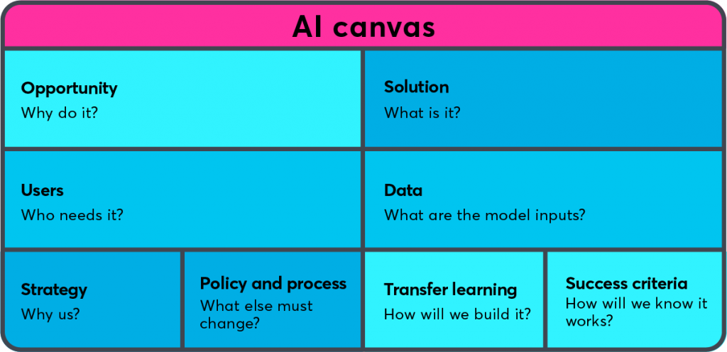
AI Canvas: provide high-level overview
MARKET RESEARCH/ PROBLEM STATEMENT
IDEA GENERATION/SOLUTION AND EVALUATION
TARGET AUDIENCE, SEGMENTATION
RESPONSIBLE AI
PoC
PoC
SKIP THIS PART
DISRUPTIVE TECH RISKS

Slide 5
Responsible AI (Fairness & Bias)
Bias, fairness, transparency and interpretability
ILO Mapping:
‘Poor’ criteria of ILO 3.1
Requirements:
Perform an EDA on the dataset with the goal to identify, and describe an instance of bias in the Imsitu dataset.
Discuss a possible ramification (e.g., harm) in terms of fairness of the identified bias instance in the Imsitu dataset.

Slide 6
Proof-of-Concept: Deep Learning
Present the final model you developed on the use-case you selected.
The dataset
Baselines
Preprocessing
CNN architecture
CNN training
Model performance
Error analysis
Iteration
ILO Mapping: The PoC slides relate to ILO 4.1 Sufficient & Good criteria

Slide 7
PoC: The dataset
Assuming you have a classification problem, is it binary, multi-class or multi-label?
Show a few examples per class
How many classes?
How many images per class?
Train/Test sizes
Image size?
How are the images labeled?
Dataset source(s)?

Slide 8
PoC: Baselines
Random guess accuracy?
Human-Level Performance?
Multilayer Perceptron?

Slide 9
PoC: Preprocessing
Explain all the preprocessing steps you did. Normalization etc.

Slide 10
PoC: CNN architecture
Show every layer using model.summary()
If you used transfer learning, describe the pre-trained model + the layers you have added to it.

Slide 11
PoC: CNN training
Which loss function is used and why?
Which optimizer and learning rate is used and why?
Which metric(s) were used and why?
Plot & interpret learning curves

Slide 12
PoC: Model performance
Show & interpret selected metrics and/or plots.

Slide 13
PoC: Error analysis
Show & interpret worst errors.

Slide 14
PoC: Iteration
You have described your finalized model. Explain how you got here from the very first model you created. Describe a minimum of two iterations you did.
On week 4, day 4, you learned 3 methods to tackle small datasets. Explain which one did you use and how it changed your model performance
On week 5 you learned about error analysis and data iteration loop. Explain what you observed in the error analysis and how did you change the dataset as a result.
And any other iteration you would like to describe.

Slide 15
Responsible AI (Transparency & Interpretability)
Bias, fairness, transparency and interpretability
ILO Mapping:
(Partially) ‘Sufficient’, and ‘Good’ criteria of ILO 3.1.
Requirements:
Discuss the trade-off between accuracy and interpretability of your AI model (applied to the Creative Brief)
Develop an AI model that balances accuracy and interpretability (applied to the Creative Brief)

Slide 16
Business Understanding Components
AI Canvas
Conduct the disruptive technology risk assessment based on the lecture provided during Data lab
How can I eliminate risks?
ILO Mapping: GOOD, EXCELLENT
Requirements:
The student conducts assessment of disruptive technology risks associated with proposed application ( Use-Case 3);
The student improves proposal for an application based on the assessment of disruptive technology risks (Use-Case 3).
[remove this slide before submission]

Slide 17
Disruptive Technology Risks
Risks
Contingency Plan
[A risk]
[Some high-level plan]

Slide 18
HCAI - Application Design:
High-level concept design:
Reiterate:
Who is the user?
What problem are you solving?
How is the app going to solve that problem?
What else is important to your app? For example:
Menu Flow?
Information flow?
Colors styles?
Interaction style?
ILO Mapping: Poor & Excellent

Slide 19
HCAI - Application Design
Algorithm Embedding:
How is the computer vision algorithm embedded?
What will the eventual algorithm detect and how?
Will the algorithm be able to do more then demonstrated in the proof-of-concept?
ILO Mapping: Poor & Sufficient

Slide 20
HCAI - Application Design:
Continuous Learning
How does the application design allow for continual (supervised) learning based on user input? Meaning users can label data and/or output, E.g.:
annotate pictures;
other data labelling means;
rate predictions/model output.
ILO Mapping: Poor & Sufficient

Slide 21
HCAI - Application Design:
Feedback
User tests results?
Client feedback?
What was processed and how?
Design implications?
ILO Mapping: Insufficient, Sufficient & Good

Slide 22
HCAI - Application Design:
Low-level design:
Detailed design of the application
How your application adds value to fundamental processes of the user case
Everything which doesn’t fit into the other boxes usually goes here…
Note that you might want to explain aspects of the low-level design using your wireframe if possible!
E.g.
User will receive notifications to do…
To improve user retention, a competitive system is introduced which does…
To warn the user for Y, a yellow colour will be used for X
ILO Mapping: Excellent

Slide 23
HCAI - Application Design:
Wireframe Prototype:
Some demo…
This is where you will actually demonstrate your wireframe to the client. You can either open your wireframe, have a link here, a video demo of you using the wireframe; as long as you clearly convey you app design using the wireframe…
ILO Mapping: Poor, Sufficient, Good & Excellent

Slide 24
Thank you!
Any questions?

